Slide 1
R in the Tidyverse
CSCI 444

Slide 2
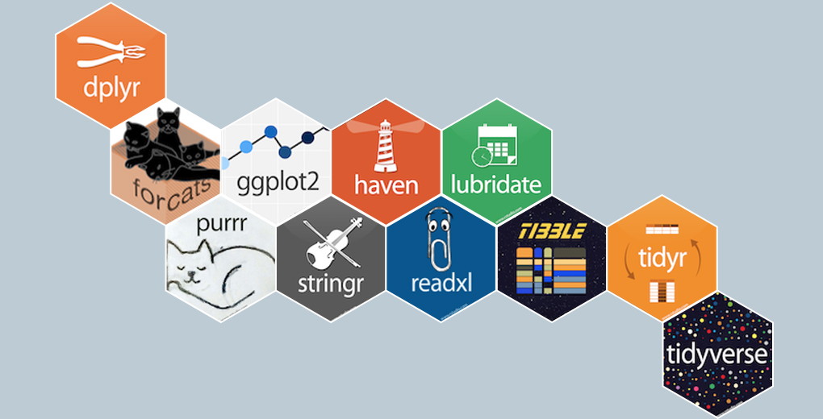
Tidyverse Packages
Collection of R packages structuring data to facilitate analysis (Ecosystem to manipulate data with a variety of different verbs)

Slide 3
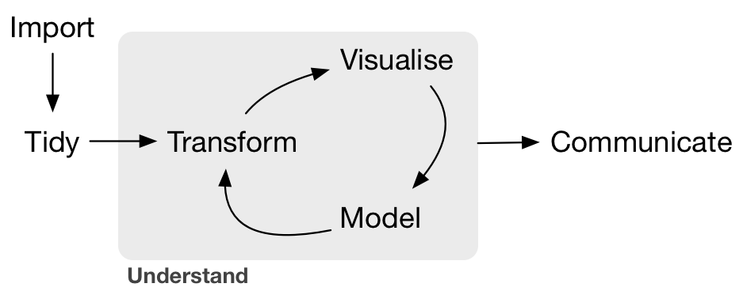
Data Science
Data Visualization
Machine Learning
Data Collection
Data Analysis
Data Conclusions

Slide 4

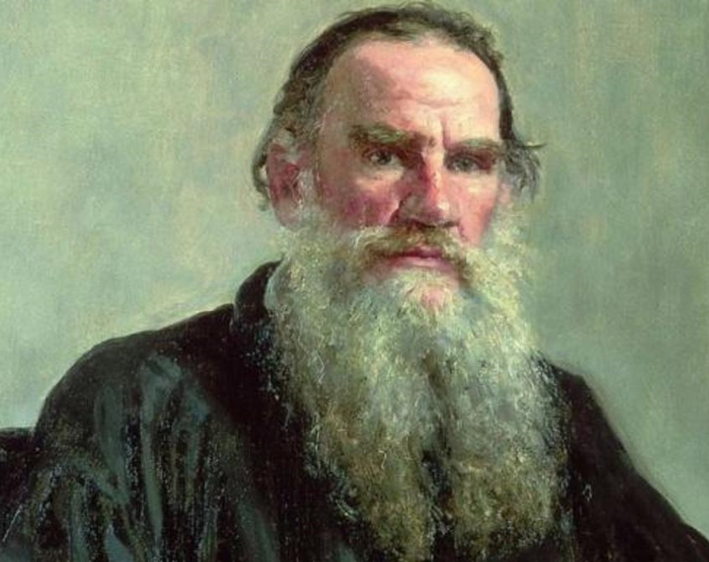
Tidyverse Developer
Hadley Wickham developed in 2014
Happy families are all alike
Every unhappy family is unhappy in its own way
Tidy data
messy data set
messy
Tolstoy
Wickham

Slide 5

Data Wrangling
Taking messy data and manipulating it into a format suited for analysis
  Data Cleaning
  Data Preparation

Slide 6

Messy Data
Common Data Problems
  Column headers contain values, not variable names
  Multiple variables are stored in a single column
  Variables stored in BOTH rows and columns
  Multiple types of observational units are in the same table
  A single observational unit is spread across multiple tables

Slide 7
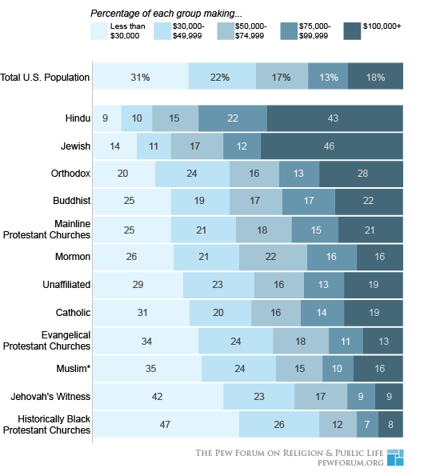
Messy Data – Individual Incomes of people who affiliate with a Religion
Column headers contain values
  Income is in the header
Transform
Religion | Income | Frequency
Hindu | $0 - $29999 | 9%
Hindu | $30000 - $49999 | 10%
Hindu | $50000 - $74999 | 15%
Hindu | $75000 – 99999 | 22%
Hindu | $100000 | 43%
And so on…

Slide 8
Messy data – Cases of Tuberculosis
Multiple values stored in a single column
  Male/Female & range of age in one column
http://594442.youcanlearnit.net/
country | year | m014 | m1524 | m2534 | m3544 | f014 | f1524 | f2534 | f3544
AD | 2000 | 0 | 0 | 1 | 0 | NA | NA | NA | NA
AE | 2000 | 2 | 4 | 4 | 6 | 3 | 16 | 1 | 3
AF | 2000 | 52 | 228 | 183 | 149 | 93 | 414 | 565 | 339
AG | 2000 | 0 | 0 | 0 | 0 | 1 | 1 | 1 | 0
AL | 2000 | 2 | 19 | 21 | 14 | 3 | 11 | 10 | 8
AM | 2000 | 2 | 152 | 130 | 131 | 1 | 24 | 27 | 24
AN | 2000 | 0 | 0 | 1 | 2 | 0 | 0 | 1 | 0

Slide 9
Messy data – Cases of Tuberculosis
Transform
  Create a group & count column instead
  What’s the new issue?
group has TWO values – gender & age
Transform again
country | year | group | count
AD | 2000 | m014 | 0
AD | 2000 | m1524 | 0
AD | 2000 | m2534 | 1
AD | 2000 | m3544 | 0
AD | 2000 | f014 | NA
AD | 2000 | f1524 | NA
AD | 2000 | f2534 | NA
AD | 2000 | f3544 | NA
country | year | group | age | count
AD | 2000 | m | 014 | 0
AD | 2000 | m | 1524 | 0
AD | 2000 | m | 2534 | 1
AD | 2000 | m | 3544 | 0
AD | 2000 | f | 014 | NA
AD | 2000 | f | 1524 | NA
AD | 2000 | f | 2534 | NA
AD | 2000 | f | 3544 | NA

Slide 10
Messy Data – Weather Data from Mexican Weather Stations
Variables in BOTH rows & columns – month, day, year
station | year | month | element | d1 | d2 | d3 | d4 | d5
MX000017004 | 2011 | 1 | TMAX | -9999 | -9999 | -9999 | -9999 | -9999
MX000017004 | 2011 | 1 | TMIN | -9999 | -9999 | -9999 | -9999 | -9999
MX000017004 | 2011 | 1 | PRCP | 0 | -9999 | 0 | 0 | 0
MX000017004 | 2011 | 2 | TMAX | -9999 | -9999 | -9999 | -9999 | -9999
MX000017004 | 2011 | 2 | TMIN | -9999 | -9999 | -9999 | -9999 | -9999
MX000017004 | 2011 | 2 | PRCP | 0 | 0 | 0 | 0 | 0
MX000017004 | 2011 | 3 | TMAX | -9999 | -9999 | -9999 | -9999 | 332
MX000017004 | 2011 | 3 | TMIN | -9999 | -9999 | -9999 | -9999 | 148
MX000017004 | 2011 | 3 | PRCP | 0 | -9999 | 0 | 0 | 0
MX000017004 | 2011 | 4 | TMAX | -9999 | 350 | -9999 | -9999 | -9999
MX000017004 | 2011 | 4 | TMIN | -9999 | 168 | -9999 | -9999 | -9999
MX000017004 | 2011 | 4 | PRCP | 0 | 0 | -9999 | -9999 | 0

Slide 11
Messy Data – Weather Data from Mexican Weather Stations
Transform
  Combine date into 1 column
  TMAX, TMIN, PRCP become own column
station | date | TMAX | TMIN | PRCP
MX000017004 | 1/1/2011 | .9999 | .9999 | 0
MX000017004 | 1/2/2011 | .9999 | .9999 | 0
MX000017004 | 1/3/2011 | .9999 | .9999 | 0
MX000017004 | 1/4/2011 | .9999 | .9999 | 0
MX000017004 | 1/5/2011 | .9999 | .9999 | 0
station | Month | Day | Year | TMAX | TMIN | PRCP
MX000017004 | 1 | 1 | 2011 | .9999 | .9999 | 0
MX000017004 | 1 | 2 | 2011 | .9999 | .9999 | 0

Slide 12
Messy Data
Multiple types of observational units in same table
  Combining weather station and TB data into ONE table
country | year | m014 | m1524 | m2534 | m3544 | f014 | f1524 | f2534 | f3544 | station | year | month | ele- ment | d1 | d2 | d3 | d4 | d5
AD | 2000 | 0 | 0 | 1 | 0 | NA | NA | NA | NA | MX000017004 | 2011 | 1 | TMAX | -9999 | -9999 | -9999 | -9999 | -9999
AE | 2000 | 2 | 4 | 4 | 6 | 3 | 16 | 1 | 3 | MX000017004 | 2011 | 1 | TMIN | -9999 | -9999 | -9999 | -9999 | -9999
AF | 2000 | 52 | 228 | 183 | 149 | 93 | 414 | 565 | 339 | MX000017004 | 2011 | 1 | PRCP | 0 | -9999 | 0 | 0 | 0

Slide 13
Messy Data
Single observational unit is spread across multiple tables
  Each month of weather data in its own data frame
station | year | month | element | d1 | d2 | d3 | d4 | d5
MX000017004 | 2000 | 2 | TMAX | -9999 | -9999 | -9999 | -9999 | -9999
MX000017004 | 2000 | 2 | TMIN | -9999 | -9999 | -9999 | -9999 | -9999
MX000017004 | 2000 | 2 | PRCP | 0 | -9999 | 0 | 0 | 0
station | year | month | element | d1 | d2 | d3 | d4 | d5
MX000017004 | 2011 | 2 | TMAX | -9999 | -9999 | -9999 | -9999 | -9999
MX000017004 | 2011 | 2 | TMIN | -9999 | -9999 | -9999 | -9999 | -9999
MX000017004 | 2011 | 2 | PRCP | 0 | 0 | 0 | 0 | 0

Slide 14

Installing Tidyverse
install.packages(“tidyverse”)
tidyverse_update() → gets latest version

Slide 15

Tibble
New data structure
  Often interchangeable with data frames
  Tidyverse IMPLICITLY converts data frames
  Data frames still used because of support for data tables (data.table)

Slide 16

Tibble
EXPLICITLY convert data to a tibble
  as_tibble() → builds tibble from existing data
    iris_tibble <- as_tibble(iris)
  tibble() → builds a tibble from scratch
    name <- c(“Mike”, “Renee”, “Matt”, “Chris”, “Ricky”)
    birthyear <- c(2000, 2001, 2002, 2003, 2004, 2005)
    eyecolor <- c(“blue”, “brown”, “hazel”, “green”, “brown”)
    people <- tibble(name, birthyear, eyecolor)
  Import with read_ files
    read_csv, read_tsv, read_delim, etc.
    Base R uses . (dot) read.csv, read.delim, etc.

Slide 17


Data Wrangling
Manipulating messy data into tidy format
tidyr
  Reshapes & transforms data
dplyr
  Workhorse for subsetting, filtering, summarizing data
  Update from plyr library
  Uses %>% to link actions
  Uses %<>% to reassign and link actions

Slide 18



Importing Data
readr
  Import from .csv, .tsv, and .txt files
  Faster than Base-R
    Assumes tidy data
  More intelligent
    Dates import as dates
    Does NOT convert strings to factors (Base-R)
    Does NOT convert column names to “safe names”
      Spaces allowed in column names but must use backticks
readxl
  Import from Excel
haven
  Import from SAS, SPSS, and STATA

Slide 19


Data Visualization
ggplot2
  Powerful and consistent graphics
  Grammar of Graphics
htmlwidgets
  Interactive/clickable charts
Shiny
  Custom interactive web apps
  Little knowledge of html & js required
  Easily embed htmlwidgets

Slide 20



Functional Programming
lubridate
  Easily manage date variables
  Parse dates
purrr
  Works with functions and vectors
stringr
  String manipulation

